Slide 1
Lab 06
Realization of a Boolean Function

Slide 2
STEP (1): A BOOLEAN FUNCTION
Consider the Boolean function:
F = A’D + BD + B’C + AB’D
Combine the 1’s in the map to obtain the simplified function for F in sum‐of‐products form.
Then combine the 0’s in the map to obtain the simplified function for F’, also in sum‐of‐products form.
Using Quartus II, draw a schematic for F and F’.
Download your design to DE0, using a switch for each input and two LEDs for F and F’. Show they are the complements of each other.

Slide 3
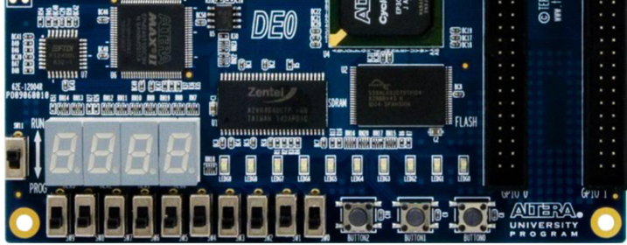
STEP (1): A BOOLEAN FUNCTION
A
B
C
D
F’
F

Slide 4
STEP (2): A DESIGN PROBLEM
Four chairs A, B, C, and D are placed in a row. Each chair may be occupied (“l”) or empty (“0”). A Boolean function F is “l” if and only if there are two or more adjacent chairs that are empty.
Give the truth table defining the Boolean function F
Express F as a minimal sum of products (SOP)
Express F as a minimal product of sums (POS)

Slide 5
STEP (2): A DESIGN PROBLEM
Use Quartus II’s graphical editor to create the design for the simplified F, and perform a functional simulation
Assign pins and download the design to your Altera DE0 board, as shown below.
A
B
C
D
Fpos
Fsop

